Slide 1


NETWORK IN CITATION
Advance Data Structure Project

Slide 2

GANESH
ADITYA GAIKWAD
01
03
ISHWAR ZATKE
HAESHIT SINGH
02
04
OUR TEAM
Prn – 22010331
Roll No – 271018
Email – ganesh.22010331@viit.ac.in
Prn – 22010088
Roll No – 271002
Email – aditya.22010088@viit.ac.in
Prn – 22010600
Roll No – 271022
Email – ishwar.22010600@viit.ac.in
Prn – 22011072
Roll No – 271021
Email – harshit.22011072@viit.ac.in

Slide 3
CONTENT
PROBLEM STATEMENT
01
02
MOTIVATION
INTRODUCTION
03
O4
PROPOSED WORK
ISSUES AND CHALLENGES
05
06
RESULTS
CONCLUSION
07
08
RESOURCES

Slide 4

PROBLEM STATEMENT
We are creating graphs for citations of different research papers which will be linked using the paper id and another for author’s collaboration which will be linked using name. All the data will be stored in a database which will contain user id and paper id with their names and citations. A search option will be given to search for the user’s and paper’s name.

Slide 5
MOTIVATION
Nowadays, many users are interested in reading/writing papers for their further research on a certain topic.
However, each existing paper has a citation (A citation identifies for the reader the original source for an idea, information, or image that is referred to in a work.)
To satisfy the users’ requirements of further research on a certain domain the correlated links among papers are very important, the recommended papers must be correlated.
Therefore, we propose a link between the citation that combines user id, paper id, and name’ information to create a citation network.

Slide 6
“Not all sources are good or right -- your own ideas may often be more accurate or interesting than those of your sources. Proper citation will keep you from taking the rap for someone else's bad ideas”

Slide 7


INTRODUCTION
A citation identifies for the reader the original source for an idea, information, or image that is referred to in a work. In the body of a paper, the in-text citation acknowledges the source of information used.
Graph are best method for creating network between different entities. Each vertex in the graph represents a document in the collection, and each edge is directed from one document toward another that it cites.

Slide 8
BOYER-MOORE ALGORITHM
Boyer–Moore string-search algorithm is an efficient string-searching algorithm that is the standard benchmark for practical string-search literature.
In general, the algorithm runs faster as the pattern length increases. The key features of the algorithm are to match on the tail of the pattern rather than the head, and to skip along the text in jumps of multiple characters rather than searching every single character in the text.
The Boyer–Moore algorithm searches for occurrences of P in T by performing explicit character comparisons at different alignments. Instead of a brute-force search of all alignments (of which there are n-m+1), Boyer–Moore uses information gained by pre-processing P to skip as many alignments as possible.

Slide 9
PROPOSED WORK
Here we have made two directed graphs where first is the authors graph where all nodes are authors and there are edges as connection specifying collaboration on a research paper or citation of the research paper.
On second graph, we have used papers as nodes and used the correlation for citations and stored the data in the database as shown in the further upcoming slides.
We have used the boyer-moore algorithm for searching for the user’s and paper’s name in the graph.
At last, we have also used graphical user interface as implementations for visualizing the two different graphs and make it more presentable.

Slide 10
ISSUES AND CHALLENGES
While implementation of this project we faced many issues and challenges. Some of them are mentioned below:
Implementation of GUI
Implementation in real life.
Implementation of boyer-moore for searching
Visualizing graphs

Slide 11
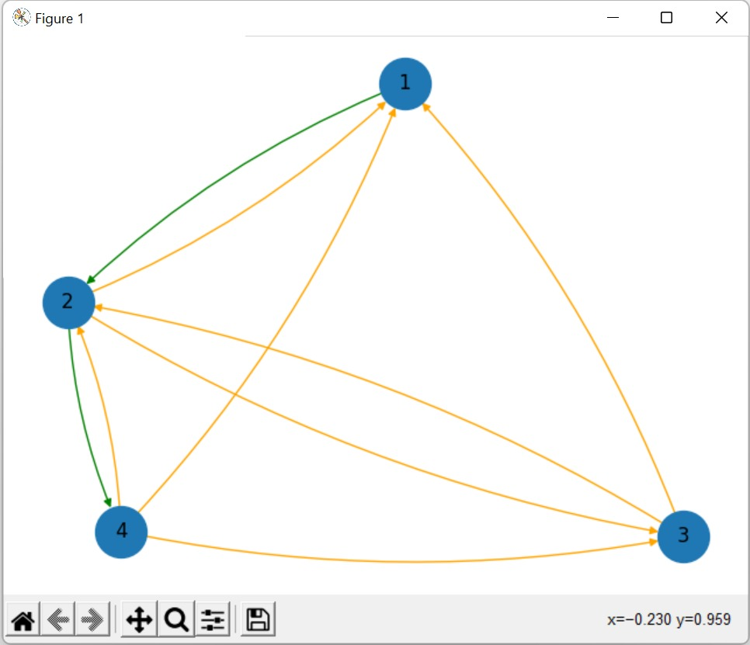
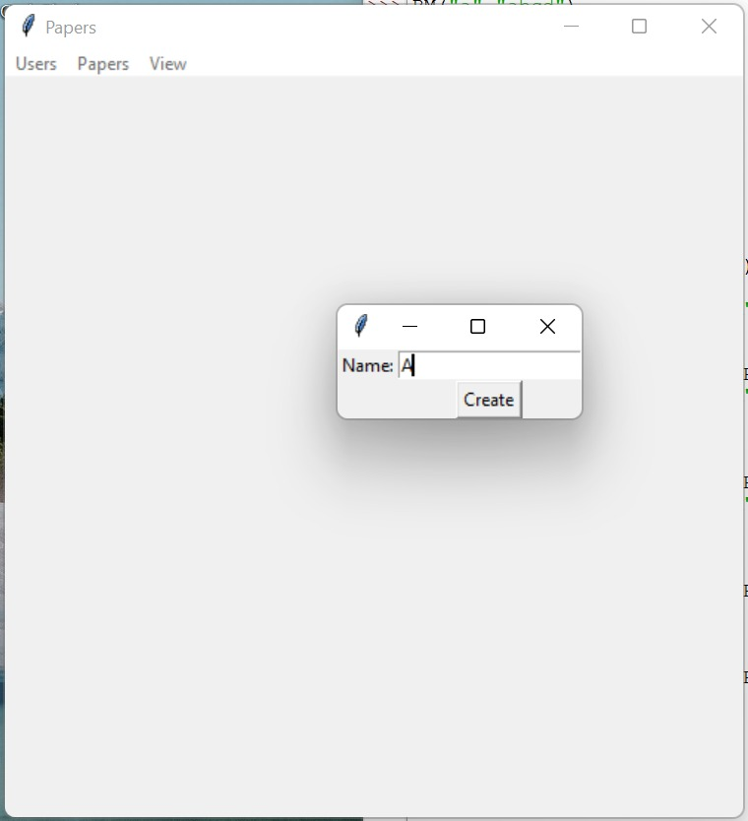
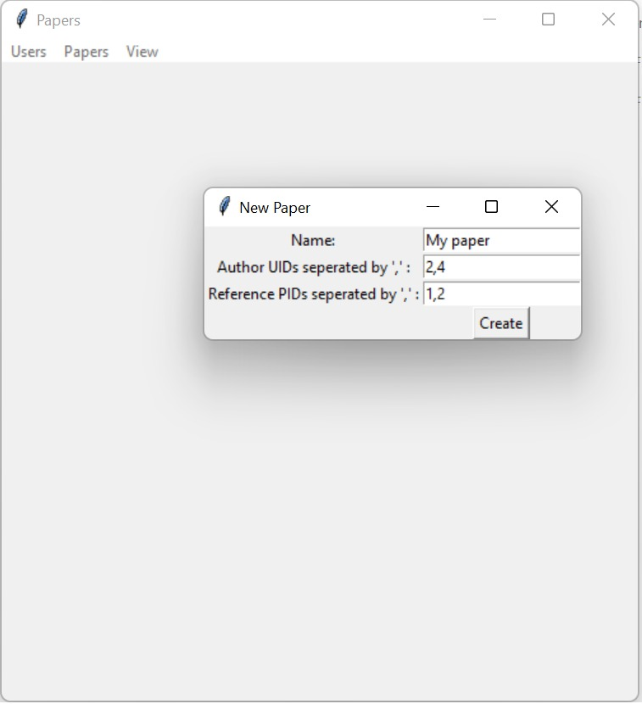
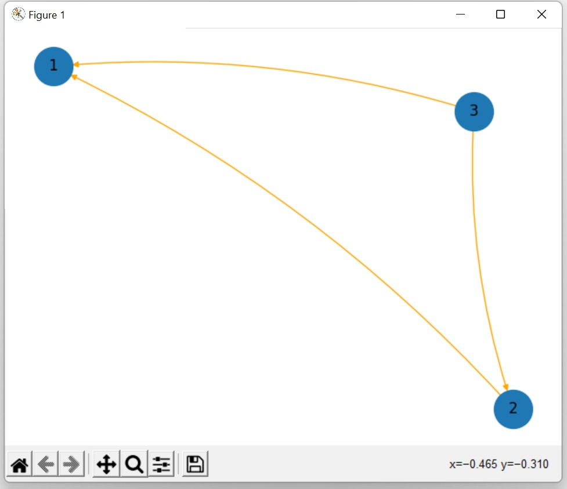
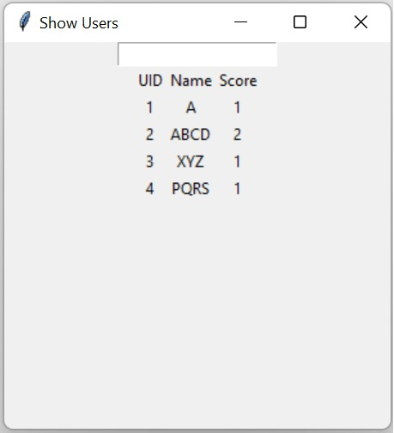
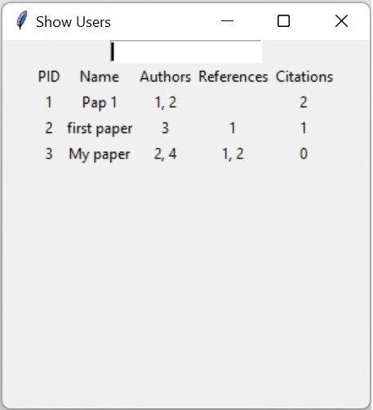
RESULTS
Graph for Users
Creating Authors
Creating Papers
Databases for User’s and paper
Graph for Papers

Slide 12
CONCLUSION AND FUTURE WORK
We are using the graph data structure for implementing the network
Thus graphs helps well to handle correlation for citations between different papers
Boyer moore Algo is also used for searching users
We have also used concepts for directed graph.

Slide 13
RESOURCES
The given coursework was completed with lots of researches which made the coursework comparatively easier. After various research and practice we were able to know how graph are used in social networks. Lots of websites, journals and books were consulted for gaining information on various important topics. All the references are mentioned below.
BOOKS
Advance data structure book
JOURNALS
A Review of Graph Based Algorithms in Social Media Data Analytics
WEBSITES
www.google.com
www.github.com

Slide 14
THANK YOU
IF YOU HAVE ANY QUESTIONS WE WILL BHI PLEASED TO SOLVE IT.

